Slide 1
Spring security 3
Maksym Titov
27.4.2011

Slide 2

Why Spring Security?
Popularity,
Features
Notes:
-it packages up everything you need to implement a top-to-bottom application security
-integration with many common enterprise authentication systems

Slide 3

Three easy steps
XML configuration file
DelegatingFilterProxy to web.xml
XML configuration reference to web.xml
Notes:
Implementing a Spring Security XML
configuration file
<?xml version="1.0" encoding="UTF-8"?>
<beans:beans xmlns="http://www.springframework.org/schema/security"
xmlns:xsi="http://www.w3.org/2001/XMLSchema-instance"
xmlns:beans="http://www.springframework.org/schema/beans"
xsi:schemaLocation="
http://www.springframework.org/schema/beans
http://www.springframework.org/schema/beans/spring-beans.xsd
http://www.springframework.org/schema/security
http://www.springframework.org/schema/security/
spring-security-3.0.xsd">
<http auto-config="true">
<intercept-url pattern="/*" access="ROLE_USER"/>
</http>
<authentication-manager alias="authenticationManager">
<authentication-provider>
<user-service>
<user authorities="ROLE_USER" name="guest" password="guest"/>
</user-service>
</authentication-provider>
</authentication-manager>
</beans:beans>
Adding the Spring DelegatingFilterProxy
to your web.xml file
<filter>
<filter-name>springSecurityFilterChain</filter-name>
<filterclass>
org.springframework.web.filter.DelegatingFilterProxy
</filter-class>
</filter>
<filter-mapping>
<filter-name>springSecurityFilterChain</filter-name>
<url-pattern>/*</url-pattern>
</filter-mapping>
Adding the Spring Security XML configuration
file reference to web.xml
<servlet>
<servlet-name>dogstore</servlet-name>
<servletclass>
org.springframework.web.servlet.DispatcherServlet
</servlet-class>
<load-on-startup>1</load-on-startup>
</servlet>

Slide 4
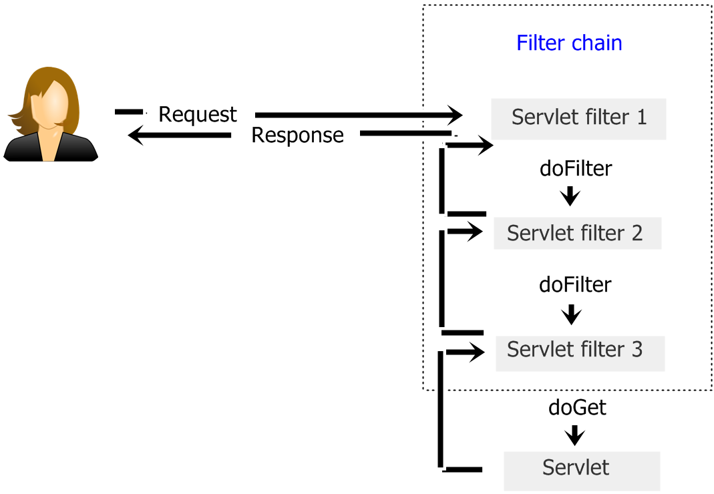
Filter chain

Slide 5

User experience
Customization
Notes:
Login page customization –
login controller
login JSP
<http auto-config="true" use-expressions="true">
<intercept-url pattern="/*" access="hasRole('ROLE_USER')"/>
<form-login login-page="/login.do" />
</http>

Slide 6

Password change management
InMemoryDaoImpl
Configuration
Page
Controller

Slide 7
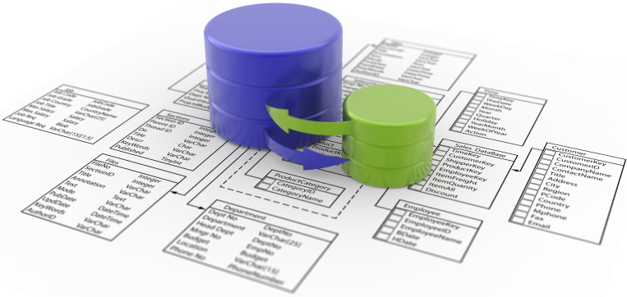
Securing Credential Storage
Database

Slide 8
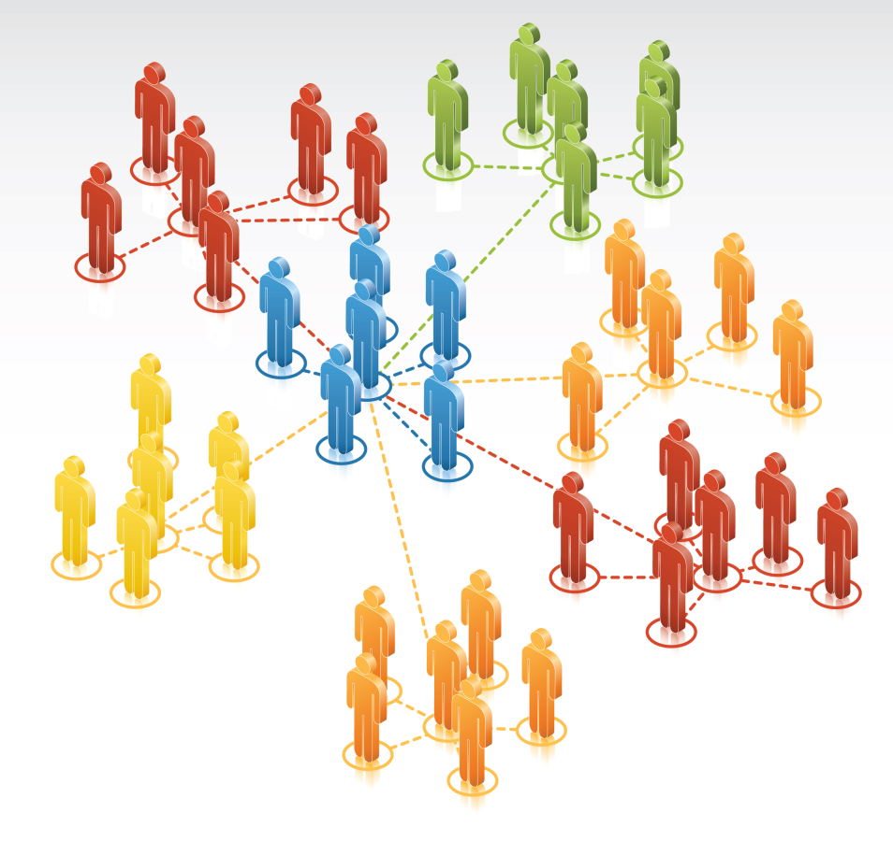
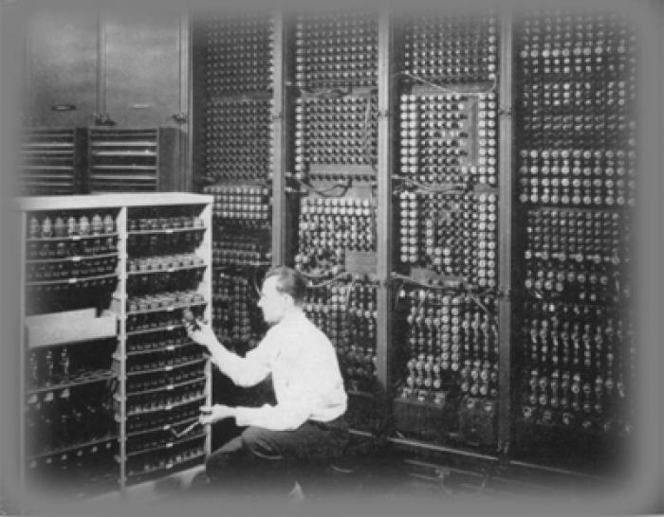
Advanced configuration of JdbcDaoImpl
User groups
Legacy schema

Slide 9

Secure passwords
Encoding, salt

Slide 10


‘Remember me’
Safe, but be careful

Slide 11




SSL
Transport layer security

Slide 12

Business layer security
public interface IUserService {
@PreAuthorize("hasRole('ROLE_USER')")
public void changePassword(String username, String password);
}
@PreAuthorize
JSR-250 compliant rules
@Secured
Aspect Oriented Programming
Conditional rendering

Slide 13

Internal customization
SECURITY FILTER
AUTHENTICATION PROVIDER

Slide 14

Session management and concurrency
Session fixation
Concurrent session control

Slide 15

Exception handling
<http auto-config="true" ...>
<access-denied-handler error-page = "/accessDenied.do"/>
</http>
AuthenticationException
AccessDeniedException

Slide 16

External security systems
Active directory
OpenId
LDAP

